Slide 1
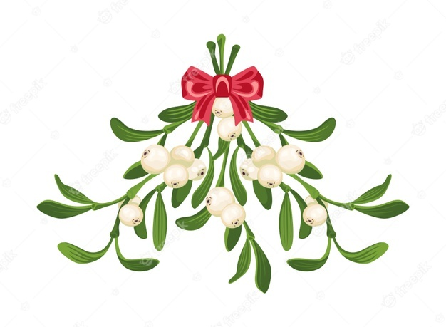
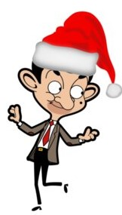
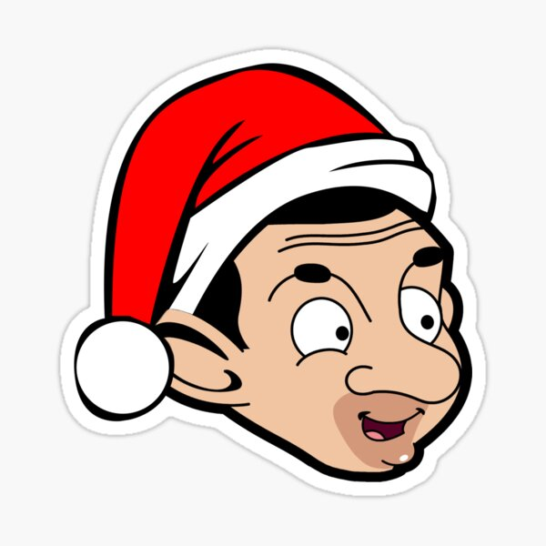
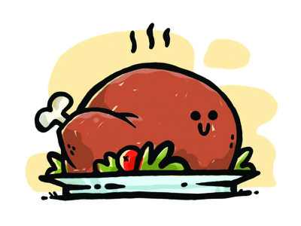
Christmas with Mr. Bean
IGS Wallstraße
English Date: 16.12.2021
7.5 Name:
Mr. Bean is preparing for the Christmas celebrations. What does he need? Connect the English word with the German one.
Toys | Weihnachtskrippe
Christmas crib | Weihnachtsbaum
Fairy lights | Spielzeug
Christmas tree ball | Weihnachtsbaumschmuck
Christmas tree | Weihnachtsbaumkugel
Christmas ornaments | Lichterkette
Let‘s watch the clip!
https://www.youtube.com/watch?v=p8adi3EY7HA (0:00 to 5:29).
Answer the following questions.
Why is Mr. Bean in the shopping centre?
____________________________________________________________ .
What does he want to buy?
____________________________________________________________ .
Why does he turn off the lights in the shopping centre?
____________________________________________________________ .
What does he do with the Christmas crib?
____________________________________________________________ .

Slide 2
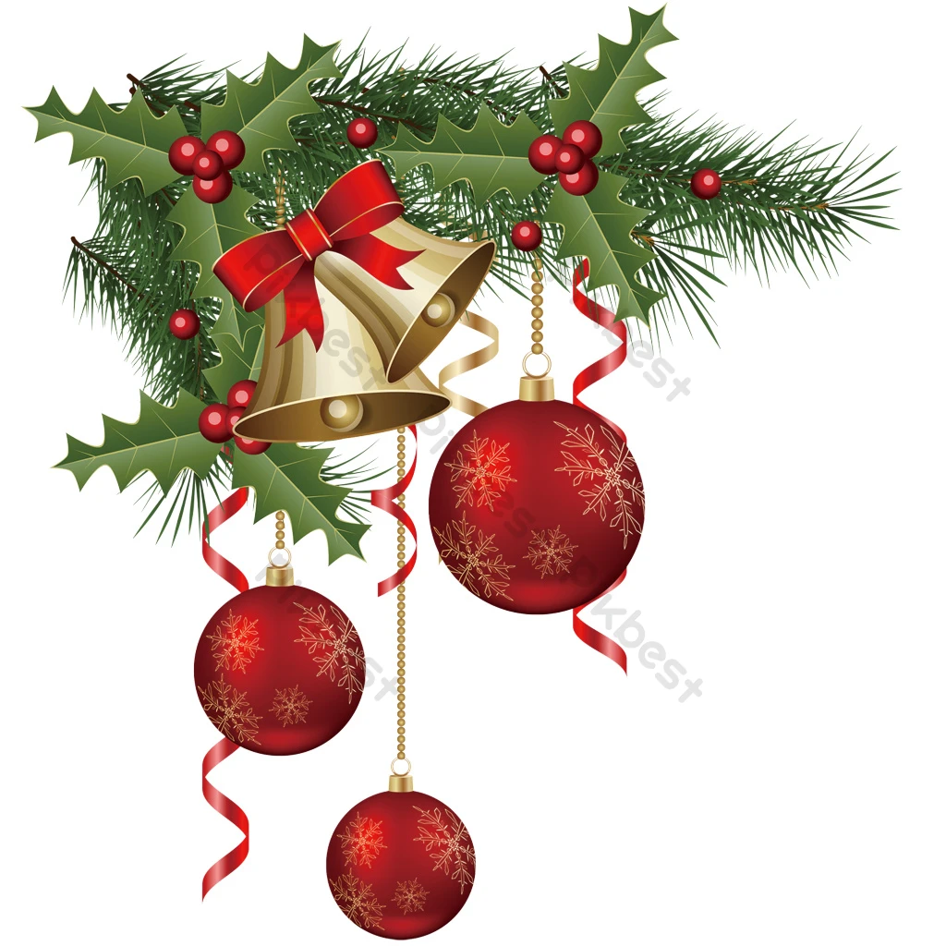
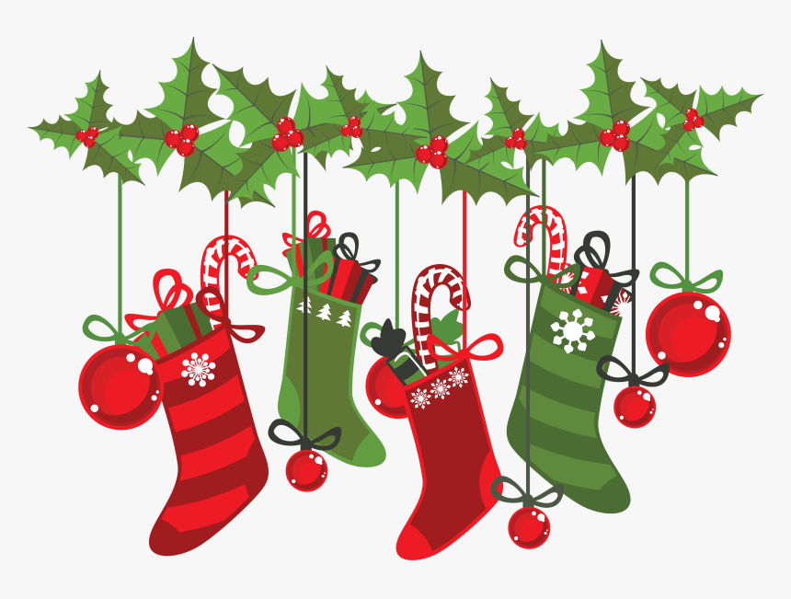
IGS Wallstraße
English Date: 16.12.2021
7.5 Name:
Christmas with
Mr. Bean
Which part was the funniest part for you?
Describe the part you think was funniest!
_____________________________________________________________
_____________________________________________________________
_____________________________________________________________
_____________________________________________________________
_____________________________________________________________
Draw Mr. Bean and Teddy in their Christmas celebrations!

